Slide 1
Title of the Invention
Movable Charging and Data-Transfer Port for Electronic Device
Inventor
Mr. Anamay Prateek
Mr. Pranav Sreenivasa Rao

Slide 2
Technical Field of Invention:
This invention relates to movable charging and data-transfer port for electronic devices. Currently, electronic devices like Laptops, come with fixed charging and data transfer ports. This results in occurrence of incidences like Wire Pulling of laptop chargers. It often creates a feeling of irritation to the users and leads to product dissatisfaction. But this invention provides a movable charging and data-transfer port having angular range, to facilitate charging/data-transfer ergonomically.
IPR Status:
Application Number : 201841009308
Priority Date : 14 March 2018
Patent Published
Key Advantages Of Investing in Early Stage:
Investing in the initial stage of such an exceptional technology is an opportunity to get licensing rights at an extremely economical price.
It provides flexibility for the modification as per requirements.
Involvement of investor's Research and Development expertise, would further enhance the quality of product.

Slide 3
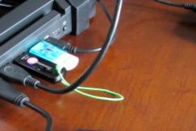
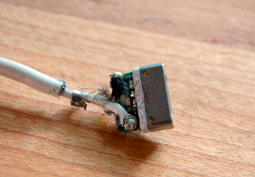
The Problem:
In current scenario, laptops are provided with charging/USB/Audio ports on either side only.
These ports are fixed.
Due to immobility, these ports restrict the ease of operation, from the user.
This usually results in damage to ports and charging/USB wire.
Having all the ports at one end of the laptop, makes the laptop look bulky and causes inconvenience in operations.

Slide 4
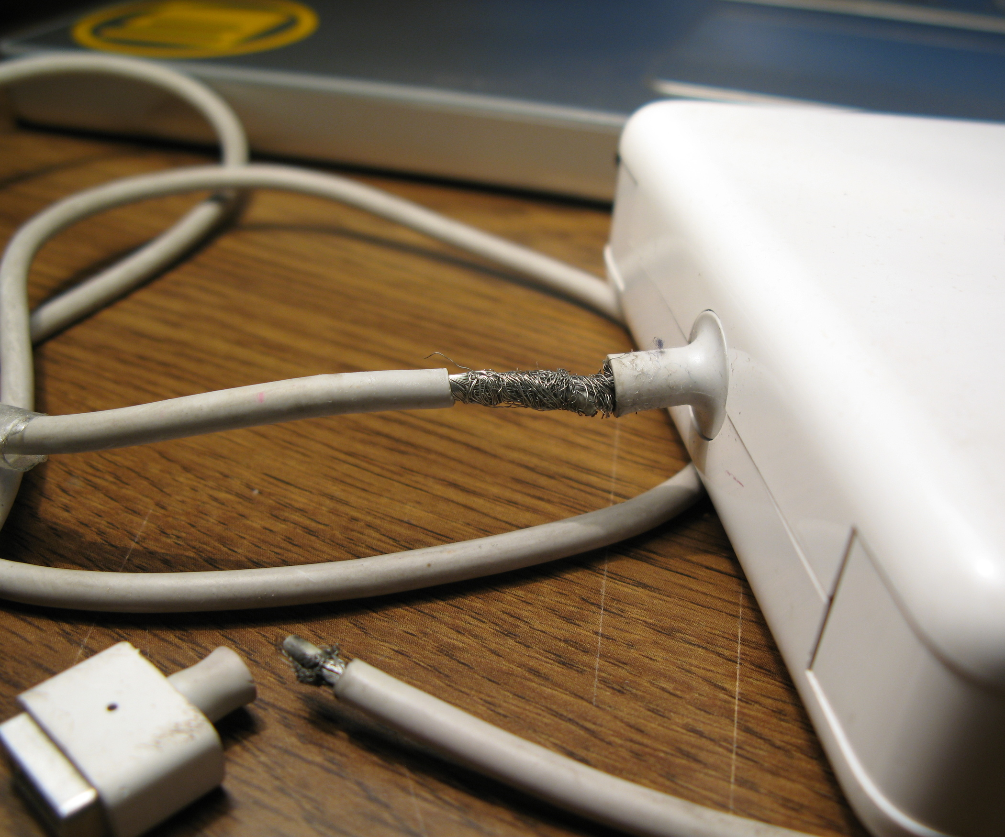
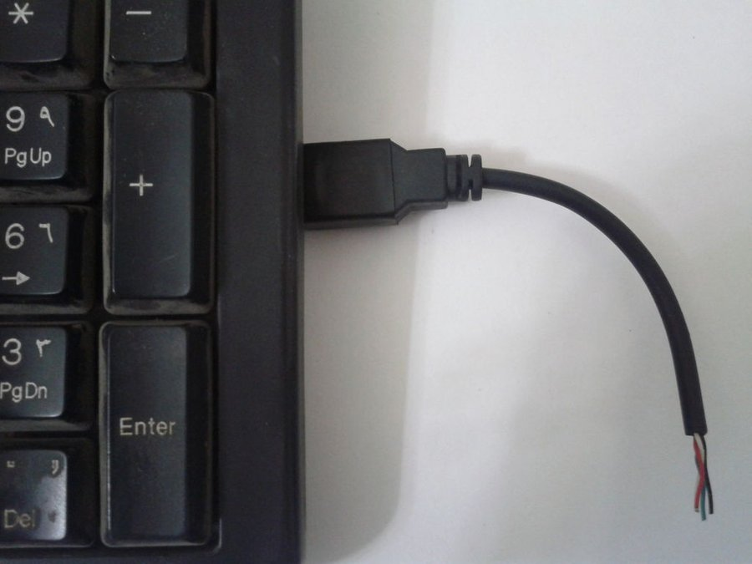
Visualization of Problem:

Slide 5
Our Invention:
Click to Play the Video

Slide 6
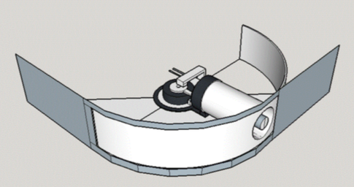
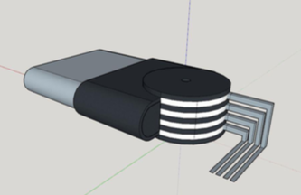
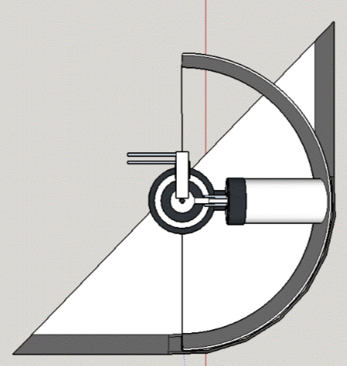
Working:
Movable charging and data-transfer port or receptacle for electronic devices comprises of a pivot mechanism attached/embedded at the rear portion of the said port or receptacle to provide angular rotatory motion. This pivot mechanism is composed of rotating conductive plates sandwiched in between rotating insulating plates pivoted with an insulating axle at the corners of the electronic device where these rotating conductive plates are directly connected to the said charging and data-transfer port or receptacle. The conductive layers of the pivot mechanism have contact with immovable solid conductive connectors to facilitate the transfer of power to the motherboard. The present invention is designed to fix at the corners of the electronic device in order to reach the electric power socket easily to enhance convenience while charging and also while transferring data to/from the said device.

Slide 7
Market Assessment:
Time | Commercial laptop | Consumer laptop | Total laptop
2016Q4 | 26.4% of 1.92M | 36.8% of 1.92M | 12,13,440
2017Q1 | 22% of 2.16M | 38.4% of 2.16M | 13,04,640
2017Q2 | 19.6% of 1.75M | 34.4% of 1.75M | 9,45,000
2017Q3 | 28.7% of 3.03M | 41.4% of 3.03M | 21,24,030
The table above shows laptop sales in India of a one year duration - Quarter 4 of 2016 to Quarter 3 of 2017.
This time period was selected to represent the sales of notebooks when demonetisation and GST were implemented which caused a negative fluctuation of sales in India.

Slide 8
* Figures shown are in percentage

Slide 9
Conclusion:
On an average 13,96,778 units of laptops are sold every quarter in India.
Based on the market assessment, it can be concluded that 67% of laptop users in India are facing problem due to fixed position of charging and USB ports.
67% of average laptop sales in India comes around 9,35,841 customers per quarter. These are the customers who are facing the problem due to fixed position of charging port.
Advantages:
This technology could be implemented with slight modification in ongoing laptops.
This would provide exclusive offering to users that could prove as Key Selling Point.
9,35,841 unsatisfied users per quarter is a huge potential for the companies to make the profit.
This could increase the revenue of the patent acquiring company by 90 crores per quarter.

Slide 10
Expectations:
We are interested in Technology Transfer for this Invention, subjected to Fees and Royalties.
We are also interested in Licensing of this invention.

Slide 11
THANK YOU

