Slide 1

DELHI. MUMBAI. BANGLORE. PUNE. INDORE. HYDERABAD. CALIFORNIA
TERI’s Enhanced Acidification & Methanation (TEAM) Process for Waste Management
Identifying Licensee/Buyout Prospects
Indian Patent Application 3875/DEL/2011

Slide 2
Background
Current practice for waste disposal
Thrown into sewer
Dumped in low-lying areas
Organic waste
A resource
Great potential to replace LPG (liquefied petroleum gas) or coal
Potential to replace chemical fertilizers with good quality organic manure

Slide 3
Waste Generation Trends In India
Year | Per Capita Waste Generation (g/day) | Total Urban Municipal Waste Generation (MT/y)
1971 | 375 | 14.9
1981 | 430 | 25.1
1991 | 460 | 43.5
1997 | 490 | 48.5
2025 | 700 | ~Double the amount of 1997
Per capita waste generation
2030
2010
1990
1970
375
430 460 490
Quantity of waste (gm)
700

Slide 4
Projected Power Generation Potential
Q uantity of solid w aste generated (TPA)
Pow er generation potential (MW)
5000
300000
4500
4000
Pow er potential (MW)
Quantity of solid w aste (MTD)
250000
3500
200000
3000
2500
150000
2000
100000
1500
1000
50000
500
0
0
2002 2007 2012 2017
Year

Slide 5
Limitations Of Existing Technologies
Scum formation in small size plants
Slurry management
Performance of imported technologies is not established to Indian waste
Large space requirement
Costs involved in maintenance of the plants
Technical skills requirement for operation and maintenance
Large water requirements
No decentralized application

Slide 6
Proposed Technology
Bi-phasic reactor
Acidification
  The organics from solid waste are extracted in the form of leachate (liquid form) by the action of hydrolytic and acidogenic microbes
  Digested slurry is rich in available nutrients which is dried and used as manure
Methanation
  The extracted organics (leachate) are treated in a high rate upflow anaerobic sludge blanket reactor to form biogas (composed of methane and carbon dioxide) by the action of acetogens and methanogens

Slide 7
Waste Management Technology

Slide 8
Key Advantages
  High rate methane producing reactor.
  Low HRT of 7 days.
  Digested waste has high NPK values.
  High methane content in biogas (>75%).
  Elimination of Scum formation - a feature in small size plants.
  Production of non-flowable/ semisolid digested residue.
  Very low water requirement due to recycling within the process.
  Successfully tested for leafy waste, food waste, press mud, food-processing waste, tea waste, vegetable market waste, township waste etc.

Slide 9
KEY ADVANTAGES
  Produces no slurry
  Elimination of Scum formation
  Aesthetic look with low maintenance cost.
  No environmental impact.
  Proven performance of pilot plant since Jan. 1999.
  High Energy and enriched manure
  Suitability for small and decentralized application
  Ease in material handling

Slide 10
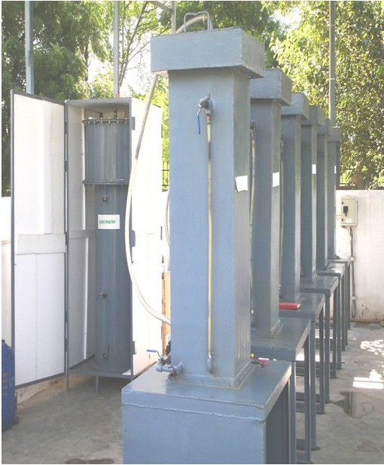
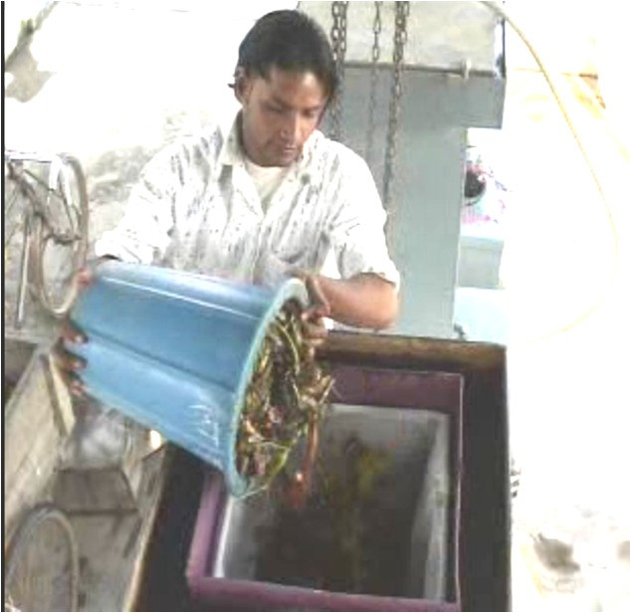
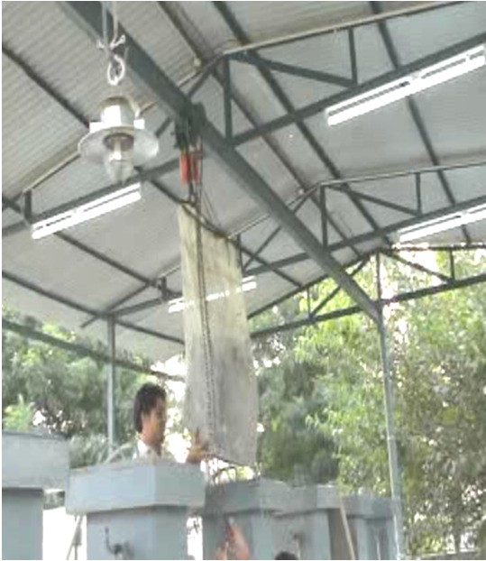
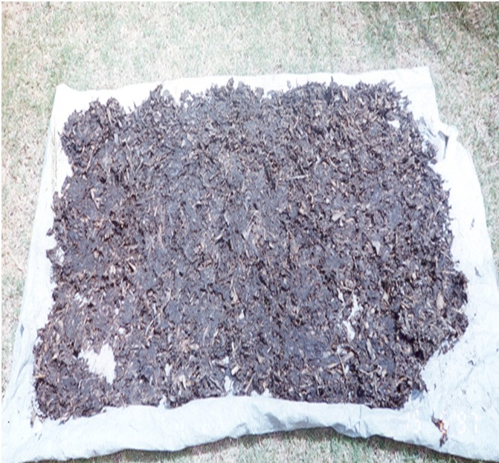
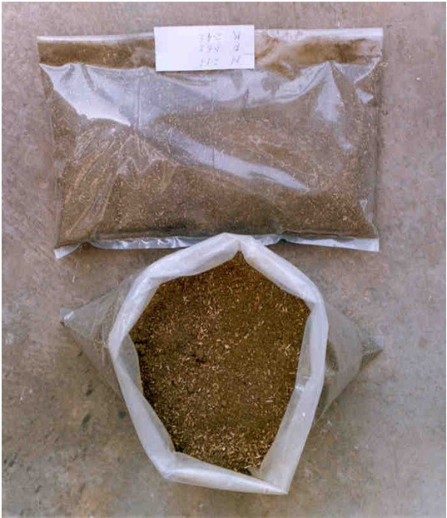
Proposed Technology - Acidification
Startup of Acidification process
Drying of digested sludge for manure production

Slide 11
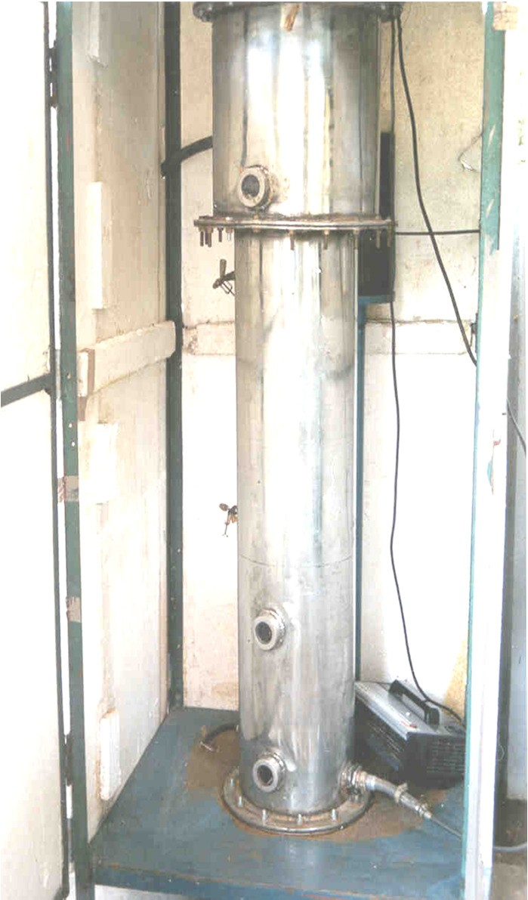
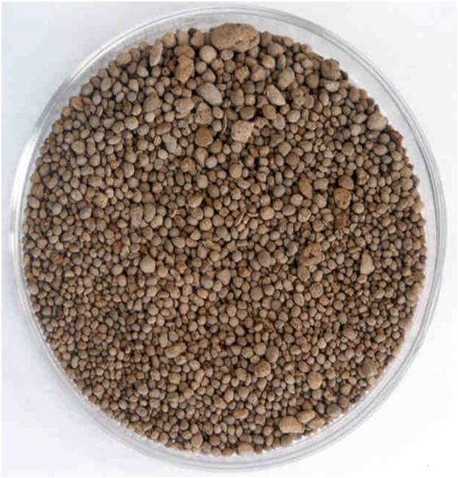

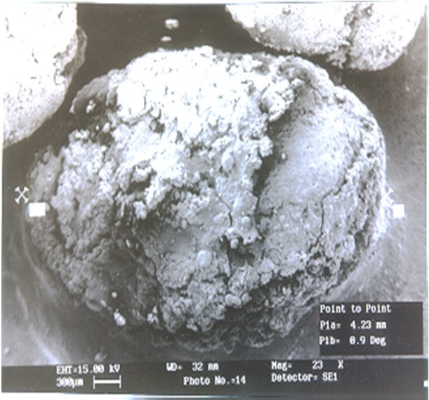
Proposed Technology - Methanation

Slide 12
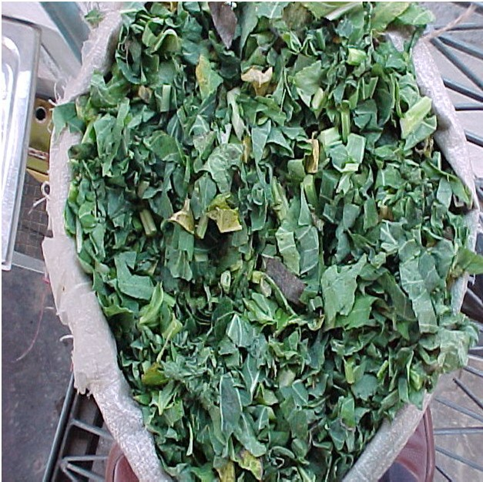
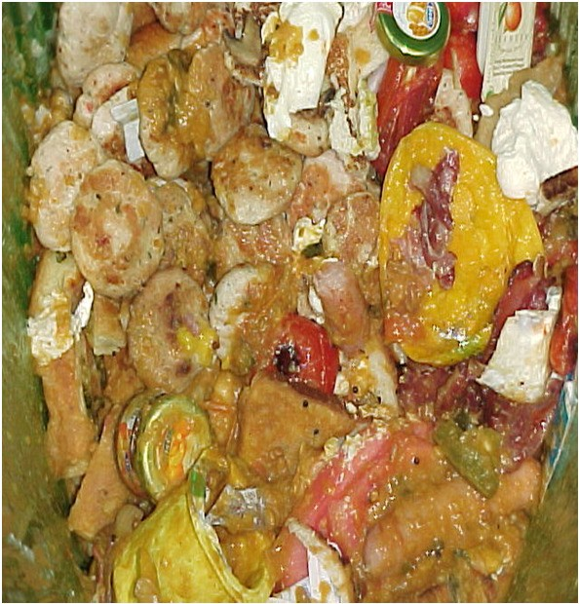
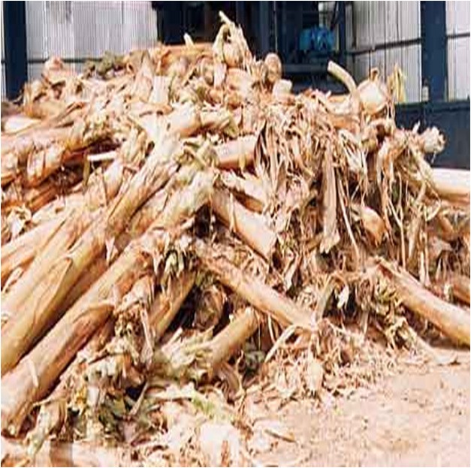

Feedstock To The Team Digester
Vegetable Market waste
Kitchen waste
Agricultural residues
Aquatic plants

Slide 13
Technology Potential
Type of waste | Biogas | ( m ³ / t ) | Manure Value
Apple waste | 3 2 . 4 |  | N P K 0. 9 0. 04 0. 43
Pineapple | 1 3 . 7 7 |  | 0. 33 0. 06 0. 51
Press mud | 8 . 9 |  | 0. 61 0. 60 0. 37
Vegetable waste | 2 0 |  | 2.1 1. 6 2. 4
Mixed waste | 2 0 . 2 5 |  | 1.2 0. 07 0. 63
Coffee Pulp | 1 0 |  | 1.8 0.1 3
Food waste | 5 4 |  | 0. 5 0.1 0 . 3
Tapioca | 6 . 1 |  | 2.3 0. 02 0. 34

Slide 14
Present Implementations
S. No. | Site Address | Capacity | Feed stock | Status
1 | NTPC, Sipat, Chhattishgarh | 1000 kg/day | Township waste | Advances stage
2 | NTPC, Kahalgaon, Bihar | 100kg/day | Canteen waste | Under erection
3 | Navi Mumbai Municipal corporation (NMMC) ,Bela Pur, Navi Mumbai | 250 Kg/day | Canteen waste | Under commissioning
4 | IBIS Hotel, Banglore, Karantaka | 100 kg/day | Food waste | Under commissioning
5 | IOCL, Refinery, Panipat, Haryana | 250 kg/day | Canteen waste | Operational
6 | IOCL, Nephtha Cracker, Panipat, Haryana | 250 kg/day | Canteen waste | operational
7 | Saptashrungi Devi Temple Place: Vani, Dindori, Nashik | 500 kg/day | Flower and food waste | operational
8 | THDC Limited, Rishikesh, Uttarakhand | 500 kg/d | Township waste | Operational
9 | NTPC, Dadari Unit, UP | 500 kg/d | Township waste | Operational
10 | Vedanta Aluminium Limited, Lanjigarh, Orissa | 1500 kg/day | Food waste | Operational
11 | NTPC, Singrauli, Distt Sonebhadra, UP | 250 kg/day | Township waste | Operational
12 | NTPC, Kawas gas project, Surat, Gujarat | 100 kg/day | Food waste | Operational
13 | IOCL, R&D center, Faridabad | 50 kg/day | Canteen waste | Operational
14 | ONGC colony, Sector 39, Noida UP | 100 kg/day | Township waste | Operational
15 | CIDCO, Bela Pur, Navi Mumbai | 250 kg/day | Canteen waste | Operational
16 | Sona Koyo Steering systems ltd.Gurgaon, Haryana | 100 kg/day | Canteen waste | Operational
17 | NTPC, Faridabad Gas Power Project, RashmiPuram, Faridabad,Haryana | 50 kg/day | Township waste | Operational
18 | TERI, Gual pahari campus, Gurgaon, Haryana | 50 kg/day | Canteen waste | Operational
19 | Numaligarh Refineries limited, Golaghat, Assam | 500 kg/day | Food waste | operational
20 | Gujarat State Fertlizers and Chemical ltd,Vadodara | 250 kg/day | Canteen waste | Operational

Slide 15
EXPECTATIONS
Applicant of the instant technology is interested in Out-Licensing or Commercialisation/Implementation of the Technology.
To tie up with Corporates and Government / Municipal Bodies for professional, scientific on-site processing of organic waste, implemented by TERI

Slide 16
PATENT/IP STATUS
Indian Application Number: 3875/DEL/2011
Application Status: Patent Pending
Publication date: 05/07/2013
Priority Date: 30/12/2011

Slide 17

DELHI. MUMBAI. BANGLORE. PUNE. INDORE. HYDERABAD. CALIFORNIA
Contact Details
Noida (NCR) Office
E-13, UPSIDC Site-IV, Behind Grand
Venice, Greater
Noida, 201308
Contact Person: Tarun Khurana
Contact No.: Ph (IN):+91 120 4296878, 4909201, 2399113
E-Mail: iiprd@iiprd.com, info@khuranaandkhurana.com
Website: www.iiprd.com | www.khuranaandkhurana.com

